Slide 1


CHRIS SUPERMARKET
GROUP 3

Slide 2



The Story Of Chris Market
Sales are good
Shelves are always being filled up
Selling more and making less money

Slide 3

STORE OWNER
CHRIS HARVELL

Slide 4

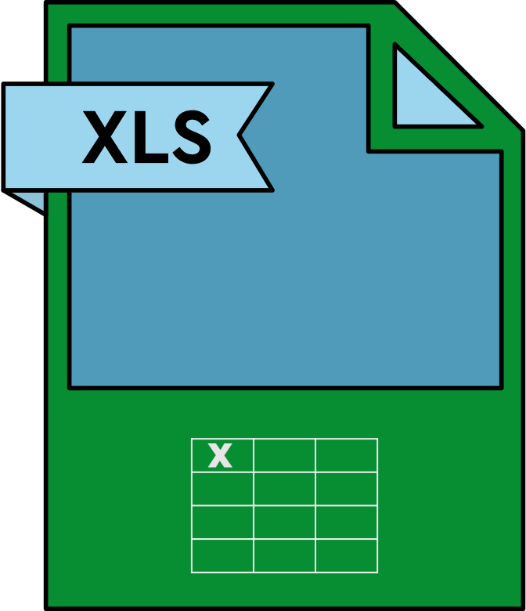
SUPERSTORE ANALYSIS TOOLS
SQL
Excel

Slide 5
SUPERSTORE ANALYSIS APPROACH
Our approach to addressing the issue involved a thorough analysis, starting with categorization, followed by sub-categorization, and then by manufacturer names.
We traced the problem back to its origin globally and conducted additional analyses to identify the root cause.

Slide 6
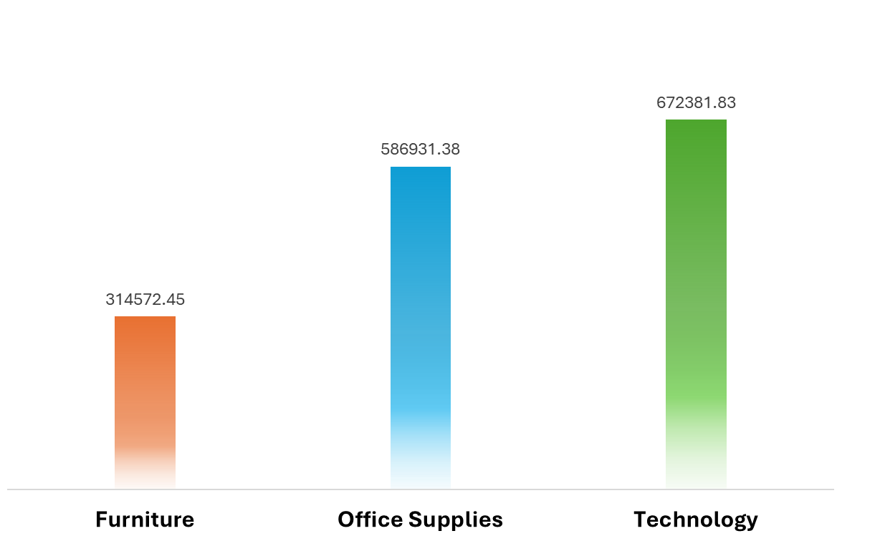
Least profitable Categories

Slide 7
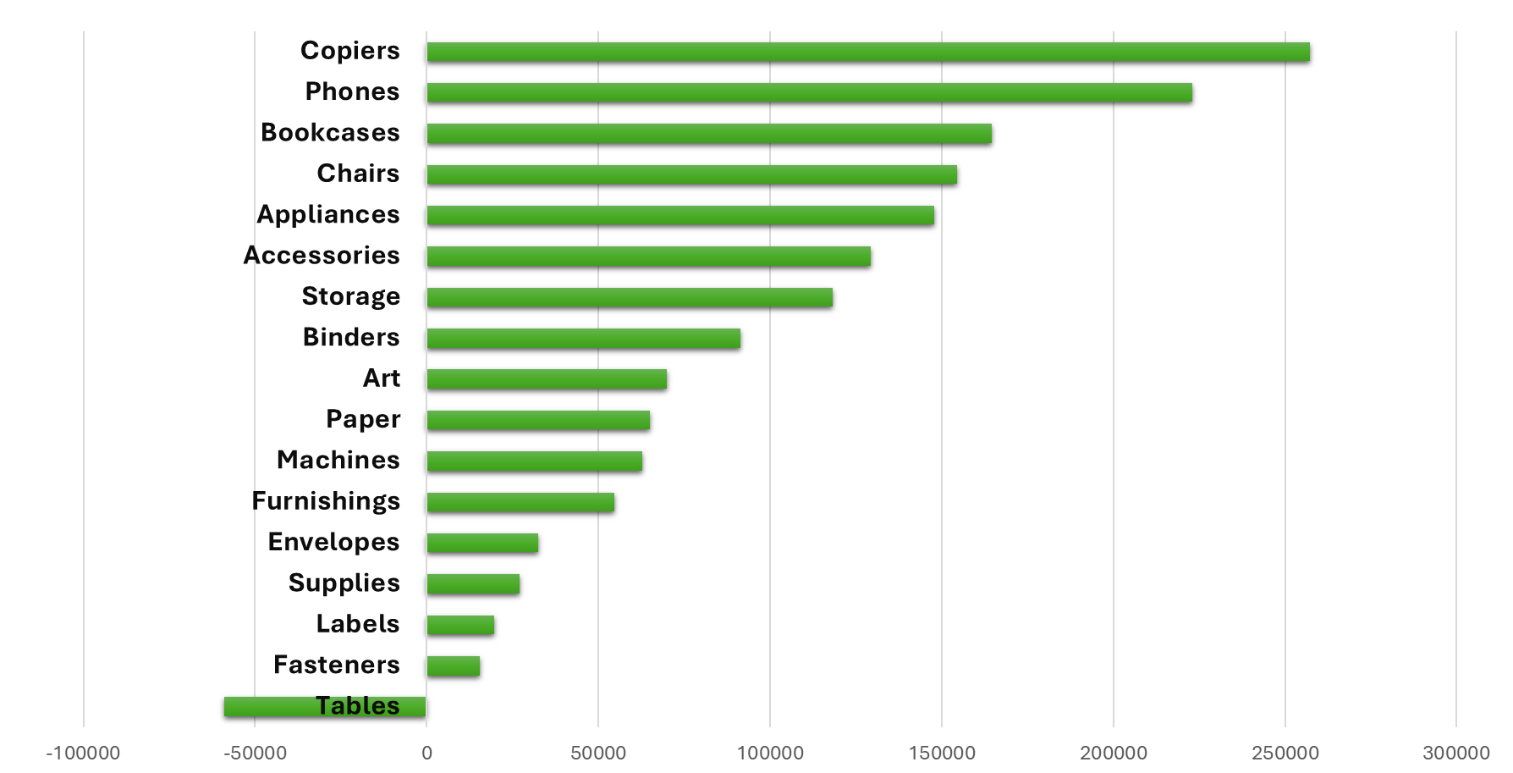
Least profitable Subcategories
MAX 257313.96
MIN -59100.82

Slide 8

Tables - Copiers
16457
Table Orders
43628
Copier Orders
1007
1801
Table Returns
Copier Returns
$93.81
Table AVG Price
$195.01
Copier AVG Price

Slide 9
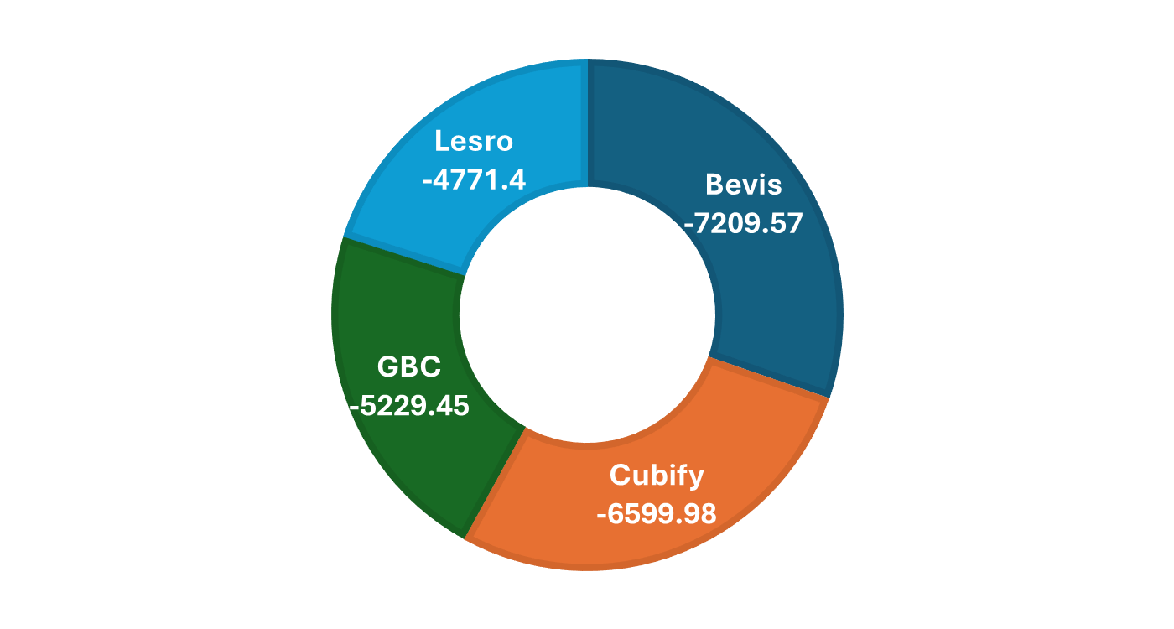
Top 4 Manufacturers in terms of loss among all countries

Slide 10
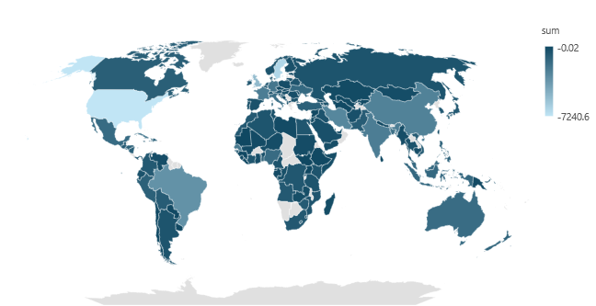

United States is the lowest among all countries with a profit of -7240.6
United States -7240.6

Slide 11
PROFIT OVER THE YEARS IN USA
Where Sub_Catigories = Tables
Ship Mode
Second Class
Standard Class
-4122.3
-5877.57
2016
2017
2018
2019
2020
-1827.96
-4371.8
18.44
First Class
Standard Class
Standard Class

Slide 12
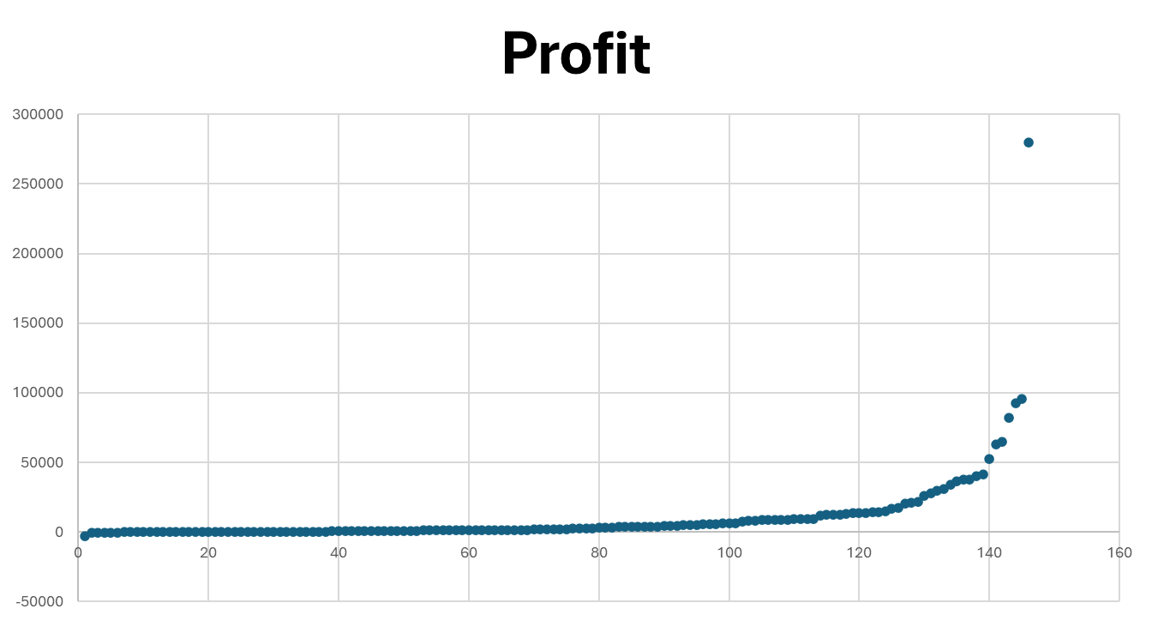
Outliers
By Applying this formula
(Profit - Average profit) / σ
We found 117 outliers
elements (Orders)
Example Profit By Countries

Slide 13





RECOMMENDATIONS
Optimize the shipping process, with a particular focus on improving efficiency and delivery times for standard-class shipments
Improve the ordering process to ensure the correct items are delivered, addressing the primary causes of returns.
Discontinue partnerships with factories responsible for losses on specific items.

Slide 14

THANK YOU

